Slide 1

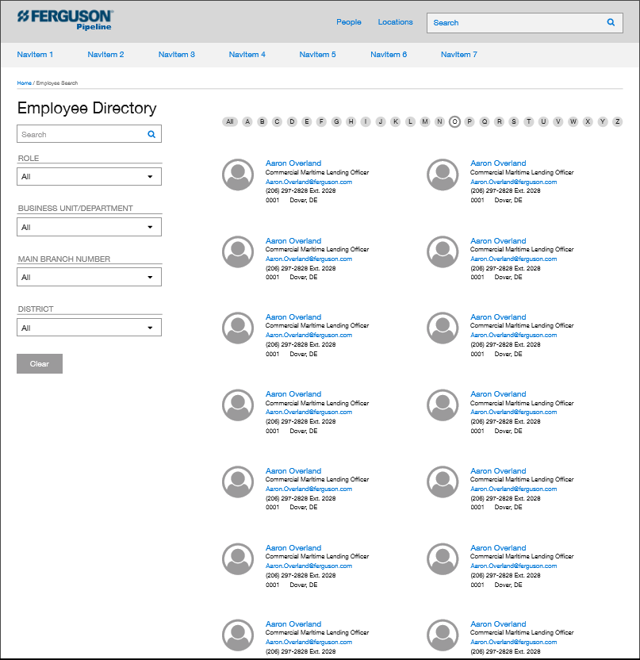
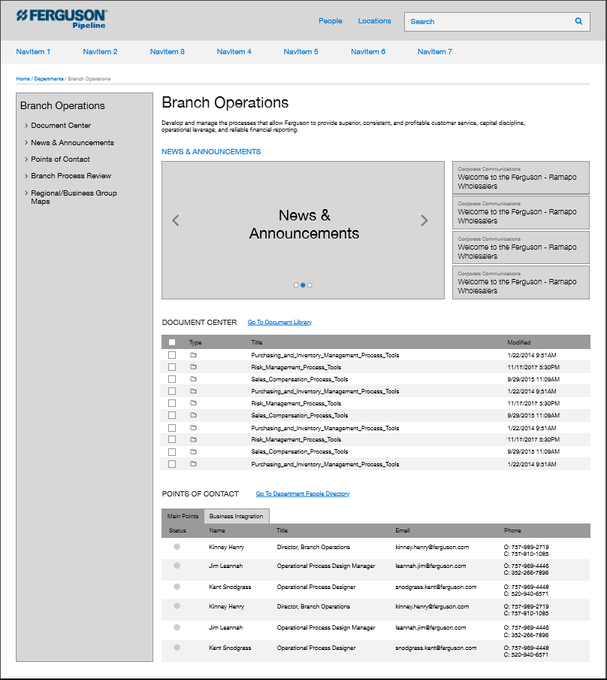
Ferguson Enterprises | SharePoint Online
Engagement Overview
Intranet redesign and migration for 23,000 user environment
Migrating from SharePoint 2010 and 2013 to SharePoint Online
Multiple operating companies in United States, Canada and Europe
Recreating 20 custom applications on SharePoint Online platform
Complex integrations with multiple line of business systems, including Workday

